Slide 1
Logo with Curved Text

Slide 2
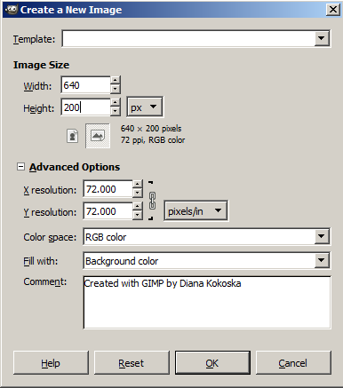
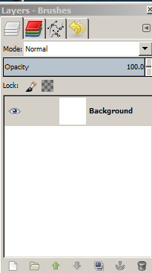
GIMP® is all about IT (Images and Text)
OPEN GIMP®
Step 1: To begin a new GIMP® project, from the Menu Bar, select File | New. At the Create a New Image dialog box, select a size and background color for your new image.
I selected 300 x 300 pixels with a white background.
You will need to click the + sign beside Advanced Options to expand the menu. In the Comment text box, describe the image. Click the OK button.
A new image canvas displays in the GIMP® workspace with image information in the Title Bar and a “Background” layer displays in the Layers palette to the right of the image window.

Slide 3
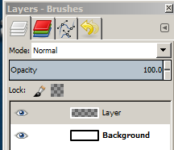
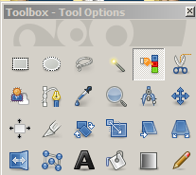
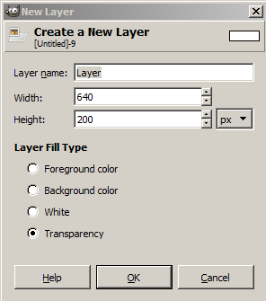
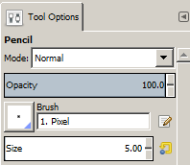
Creating a logo with curved text is similar to working with WordArt. WordArt is text with special effects. You can create shadowed, skewed, rotated, and stretched text, as well as text with particular shapes.
Before you learn to make the Geek Logo, you should learn a little about creating paths.
Step 2: Click the Create a new layer and add it to the image icon in the Layers palette.
A new layer named Layer displays above the Background Layer in the Layers palette.
Step 3: At the New layer dialog box, make sure Transparency is selected and click the OK button.
With the Layer selected, select the Pencil tool from the Toolbox
In the Pencil tool options, select the smallest Brush size

Slide 4
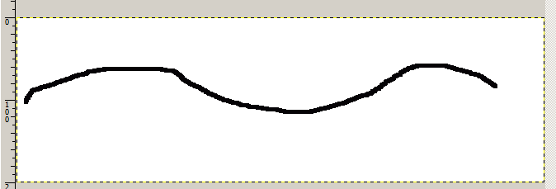
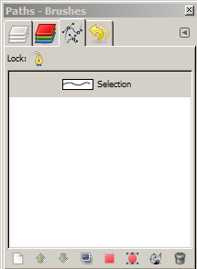
Step 4: Click on the canvas and draw a wavy line.
Step 5: With Layer selected in the Layers palette, right click and select Alpha to Selection
Step 6: Click the Paths dialog icon on the Layers palette and click the Selection to path icon.
A Selection icon displays in the Paths dialog and marching ants display around the wavy line.
Step 7: Click the unhide icon beside the Selection path to display the eyeball and display the path.

Slide 5
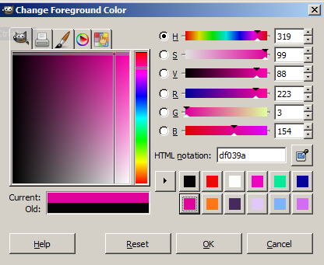
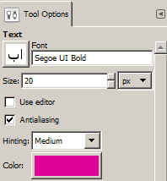
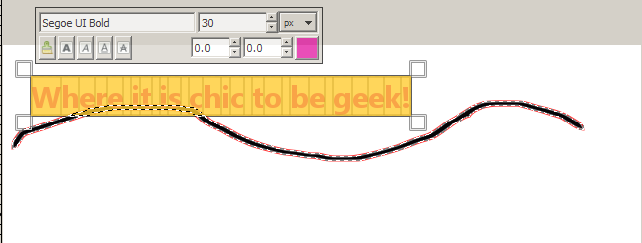
Step 8: Change the foreground color to the color you want for your text and click the OK button.
Step 9: Click the Text icon from the Tool Box and change the font size and font color in the Text Tool options.
Step 10: Click anywhere on the canvas and type “Where it is chic to be geek!”
The font looks a little small – highlight the text and change the size to 30.
Click outside the canvas.

Slide 6
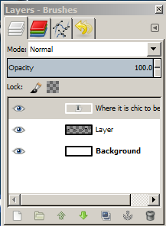
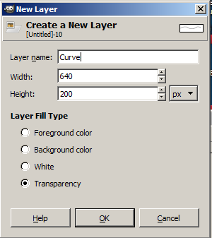
Step 11: From the Menu Bar, select Layer | Text Along Path to make the text follow the selected path.
Step 12: Now go to the Layers palette and delete the text layer (“Where it is chic to be geek”)– Just right click and select Delete Layer.
Step 13: With Layer selected, click the Add a new layer and add it to image icon at the bottom of the Layers palette.
Name the new layer “Curve” and click the OK button. A new layer named “Curve displays above the Layer layer.

Slide 7
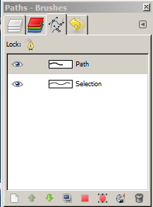
Step 14: Click on the new “Curve” layer and click the Paths dialog icon. Click the Path layer and click the Path to Selection icon at the bottom of the Paths dialog to display marching ants around the text.
Step 15: From the Menu bar, select Edit | Fill with foreground color to fill the text with the selected text color.
Step 16: Choose Select | None or press Alt+Ctrl+A to remove the marching ants.

Slide 8
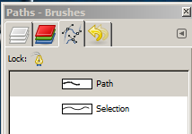
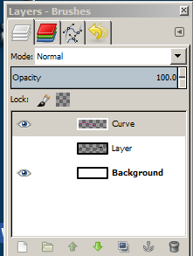
Step 17: Click the Hide icon (eyeball) to the left of the Selection and the “Where it is chic…” layer in the Paths dialog.
Step 18: Now go to the Layers dialog and hide the Layer layer.
The text now displays as wavy text!
Step 19: You can use the Crop tool in the tool box to crop the image and hide the Background layer in the Layers palette. Voila – I do think you’ve got it!

Slide 9
Step 20: You can now save the image as a .xcf file and as a .png file.
Now that you know how to use paths – let’s create a logo with curved text!

Slide 10
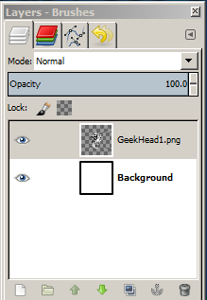
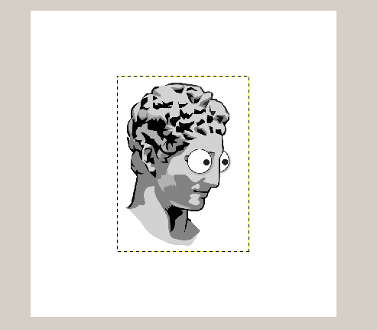
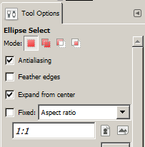
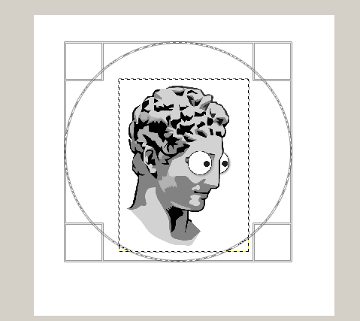
Step 1: Open Gimp and select File | New. Select a 400px by 400px canvas with a white background.
Step 2: Drag image GeekHead1.png to the center of the canvas. A new layer displays in the Layers palette above the Background layer.
Step 3: Click the Ellipse Tool in the tool box . In the Ellipse Tool Options, make sure the Ellipse Mode is Replace Current Selection and select Fixed and 1.1 Ratio. This simply means that the height and width are equal. Also select Expand from center from the Ellipse Select options.
Step 4: Click in the center of the GeekHead image and drag diagonally to draw a circle around the head. This circle will be the path that your text will follow.

Slide 11
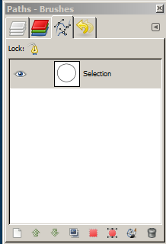
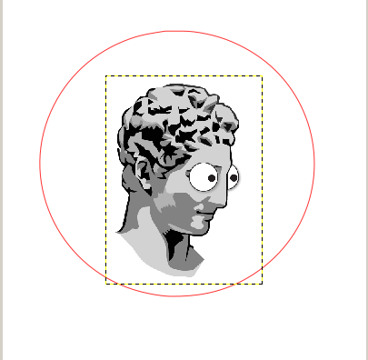
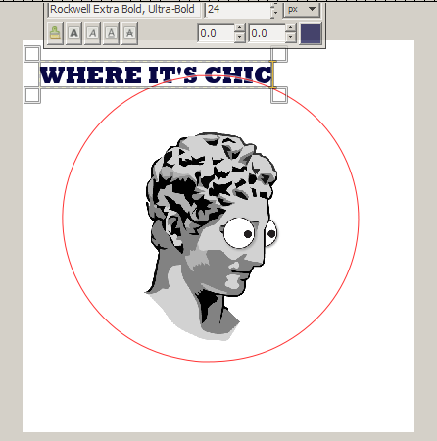
Step 5: Click the foreground color and change to navy blue.
Step 6: In the Layers palette, click the Open Paths dialog screen and click the Selection to Path icon at the bottom of the Paths dialog box.
Step 7: From the Menu bar, click Select | None to remove the marching ants.
Step 8: Click the Text Tool and select the font face and font size (I selected Rockwell Extra Bold, Ultra-Bold and size 24)
Step 9: Click anywhere in the canvas and type “WHERE IT’S CHIC”

Slide 12
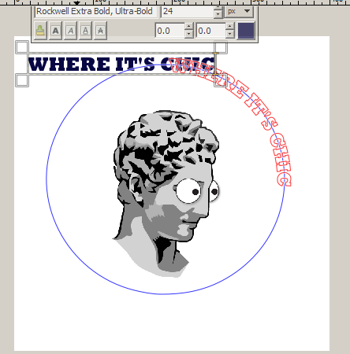
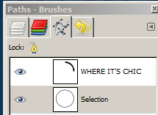
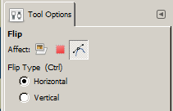
Step 10: From the Menu Bar, select Layer | Text along path to bring the text along the right curve of the circle path.
Step 11: In the Path dialog box, click on the Selection layer
Step 12: Select the Flip Tool in the tool box and click the Path icon in the Flip Affect options.

Slide 13
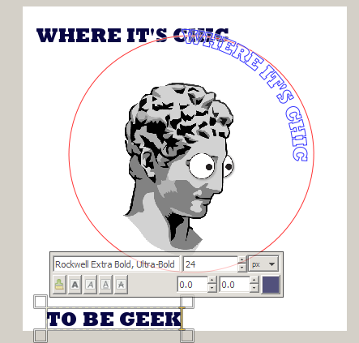
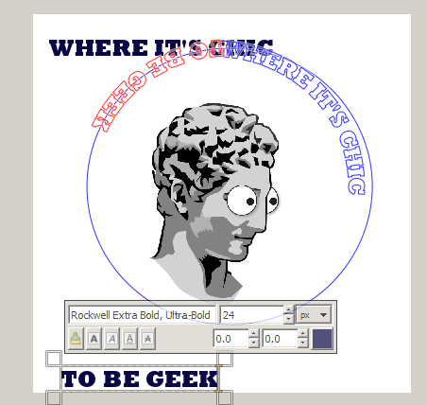
Step 13: Click the left side of the circle path surrounding the GeekHead image.
Step 14: Select the Text Tool and type “TO BE GEEK”
Step 15: From the Menu bar, select Layer | Text along Path to bring along the left curve.
Step 16: Click the Layers dialog box and right click and delete the two layers:
TO BE GEEK
And
WHERE IT’S CHIC

Slide 14
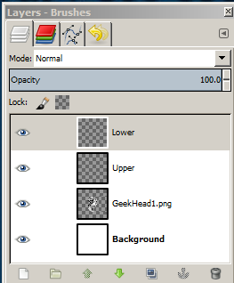
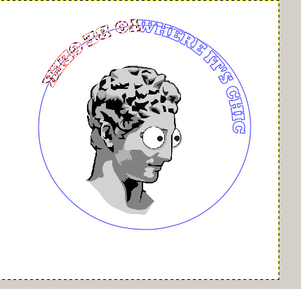
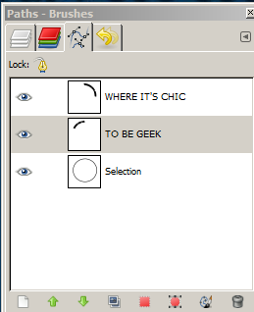
Step 17: In the Layers palette, click the Create a new layer and add it to the image icon twice:
Once to add a layer named Upper and once to add a layer named Lower
Step 18: Click on the Lower layer and then go to Path’s palette and click on TO BE GEEK and make it a selection by clicking the Path to Selection icon at the bottom of the Path’s dialog. This should display marching ants around the text.

Slide 15
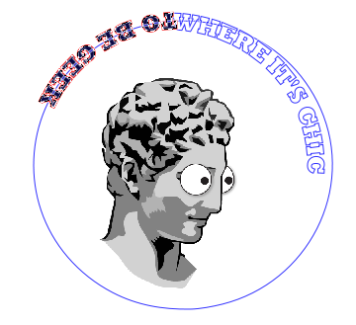
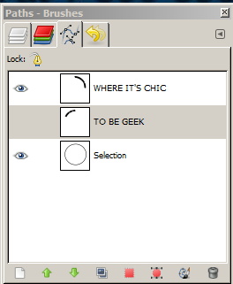
Step 19: From the Menu bar, select Edit | Fill with FG color.
Step 20: From the Menu bar, select Edit | Fill with FG color.
Step 21: In the Paths dialog, hide the TO BE GEEK layer and click Select | None to remove the marching ants.
Step 22: Now go to the Layers dialog and click the Upper layer and then go to the Paths dialog and click the WHERE IT’S CHIC layer and click the Path to Selection icon to turn on the marching ants.
From the Menu bar, select Edit | Fill with FG color
In the Paths dialog, hide the WHERE IT’S CHIC layer and click Select | None to remove the marching ants.
Let’s leave the Selection layer visible while we position the text around the circle.

Slide 16
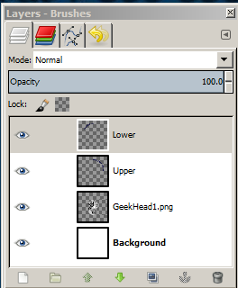
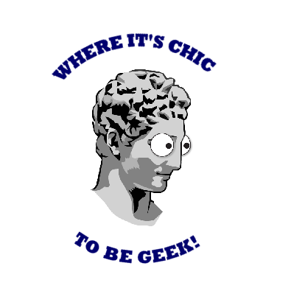
Step 23: Click the Layers palette and click the Lower Layer.
Step 24: Click the Rotate Icon in the tool box and in the Rotate options make sure that the Transform is Layer.
Step 25: Drag to rotate the TO BE GEEK text to the bottom of the circle.
Step 26: Click the Upper Layer and drag to rotate the WHERE IT’S CHIC text to the top of the circle.
Step 28: If you want to move the text a bit closer to the image, select the layer in the Layers palette and use the Move Tool to position the text.

Slide 17
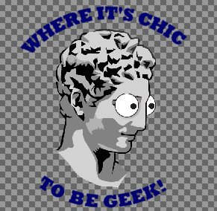
Step 28: Add the finishing touches, such as cropping the image and hiding the background to make it a transparent image.
Step 29: This does look a bit large; you may want to use the Image | Scale Image option to make it a bit smaller.
Step 30: Save the finished image as a .xcf file and as a .png file.

